Slide 1
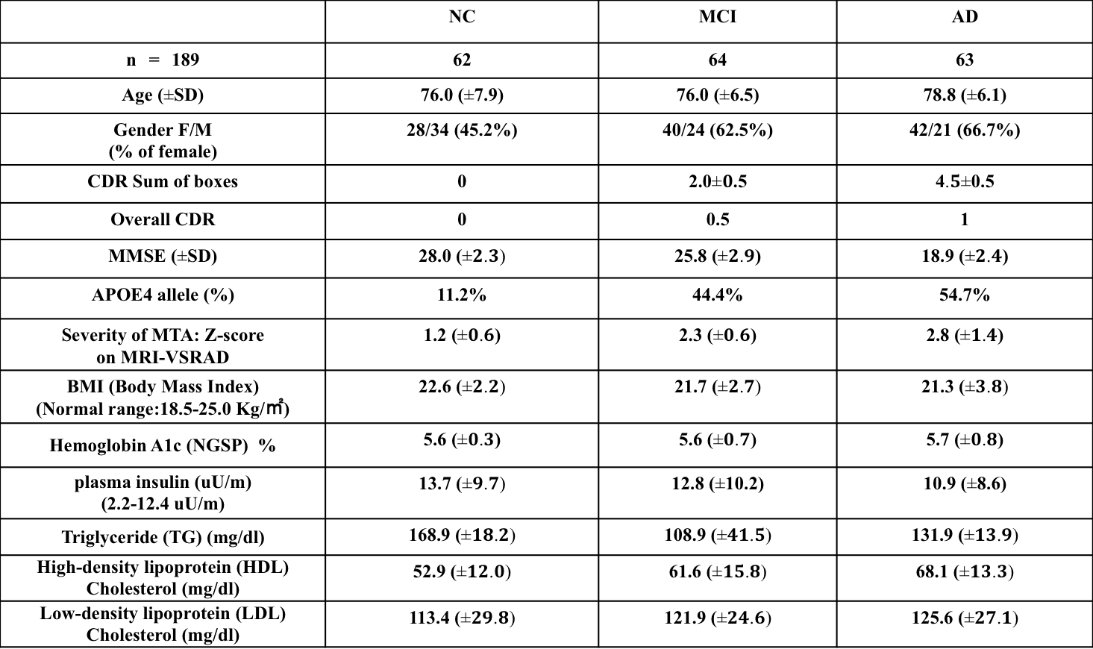
Supplementary Table 1. Demographic and clinical data of the 187 subjects.
 | NC | MCI | AD
n = 189 | 62 | 64 | 63
Age (SD) | 76.0 (7.9) | 76.0 (6.5) | 78.8 (6.1)
Gender F/M (% of female) | 28/34 (45.2%) | 40/24 (62.5%) | 42/21 (66.7%)
CDR Sum of boxes | 0 | 2.0.5 | 40.5
Overall CDR | 0 | 0.5 | 1
MMSE (SD) | 28.0 ( | 25.8 () | 18.9 ()
APOE4 allele (%) | 11.2% | 44.4% | 54.7%
Severity of MTA: Z-score on MRI-VSRAD | 1.2 () | 2.3 () | 2.8 ()
BMI (Body Mass Index) (Normal range:18.5-25.0 Kg/㎡) | 22.6 ( | 21.7 ( | 21.3 (
Hemoglobin A1c (NGSP) % | 5.6 () | 5.6 () | 5.7 ()
plasma insulin (uU/m) (2.2-12.4 uU/m) | 13.7 ( | 12.8 (10.2) | 10.9 (8.6)
Triglyceride (TG) (mg/dl) | 168.9 ( | 108.9 ( | 131.9 (
High-density lipoprotein (HDL) Cholesterol (mg/dl) | 52.9 ( | 61.6 ( | 68.1 (
Low-density lipoprotein (LDL) Cholesterol (mg/dl) | 113.4 ( | 121.9 ( | 125.6 (

Slide 2
Supplementary Fig. 1
Pearson r: -0.016, p value : 0.859 (n.s.)
Pearson r: -0.127, p value : 0.161 (n.s.)
Pearson r: -0.068, p value : 0.458 (n.s.)
Pearson r: -0.170, p value : 0.062 (n.s.)

