Slide 1
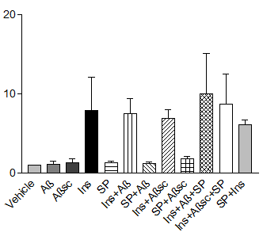
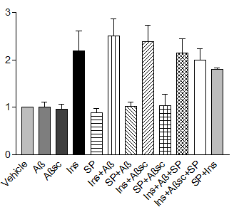
Bamji-Mirza et al. Supplemental Fig. 1
A) p-cJun
B) p-IR
C) p-AKT
P<0.05
P<0.05
P<0.05
P<0.05
P<0.05
P<0.05
P<0.001
P<0.01
P<0.001
P<0.05
P<0.05
P<0.001
P<0.01
P<0.001
P<0.001
P<0.05
P<0.001
P<0.001
P<0.05
P<0.001
P<0.05
P<0.01
P<0.001
P<0.05
P<0.05
P<0.001
P<0.01
Fold-change relative to vehicle
Fold-change relative to vehicle
Fold-change relative to vehicle

Slide 2
Bamji-Mirza et al. Supplemental Fig. 2
A
RFX2
MAX
ZNF174
RFX3
PAX5
MBP-1, aka HIVEP1
XBP1
PRD1-BFc, aka IRF2
OCT, aka POU5F1
TFE3
MEF2A
RFX1
1
2
3
4
5
6
7
8
9
10
11
12
B
CBFB
TFE3
NF-Atx, aka NFATC3
Pit-1, aka POU1F1
CEBP, aka CEBPA
1
2
3
4
5
C
EKLF, KLF1
NF-E1/YY1, aka YY1
MBP-1, aka HIVEP1
CEBP, aka CEBPA
E2F1, aka E2F TF1
ZNF174
STAT3
HiNF/D3, aka HINFP
LyF, aka IKZF1
GKLF, aka KLF4
1
2
3
4
5
6
7
8
9
10

