Slide 1
Figure S1. Recurrent non-coding mutation frequencies across NMIBC risk groups and MIBC.
% cases mutated
LR-NMIBC IR-NMIBC HR-NMIBC MIBC

Slide 2
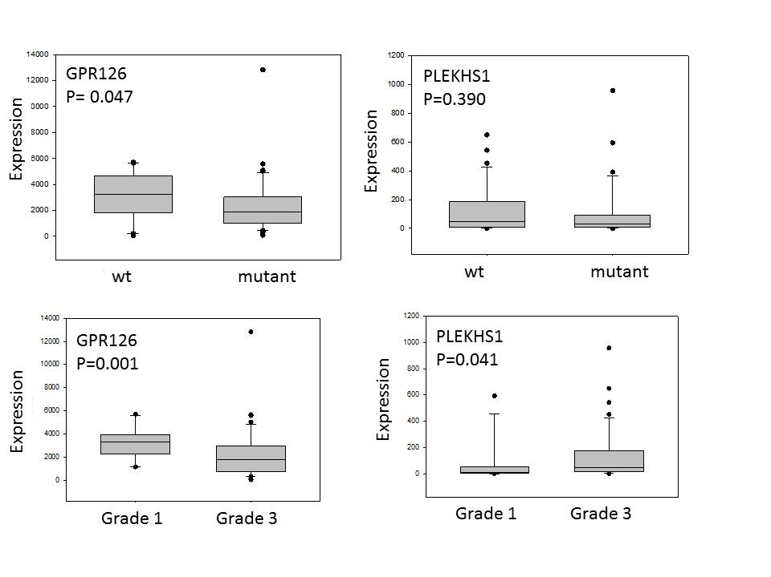
Figure S2. GPR126 and PLEKHS1 gene expression in wt and mutant tumours and grade 1 and grade 3 disease.

Slide 3
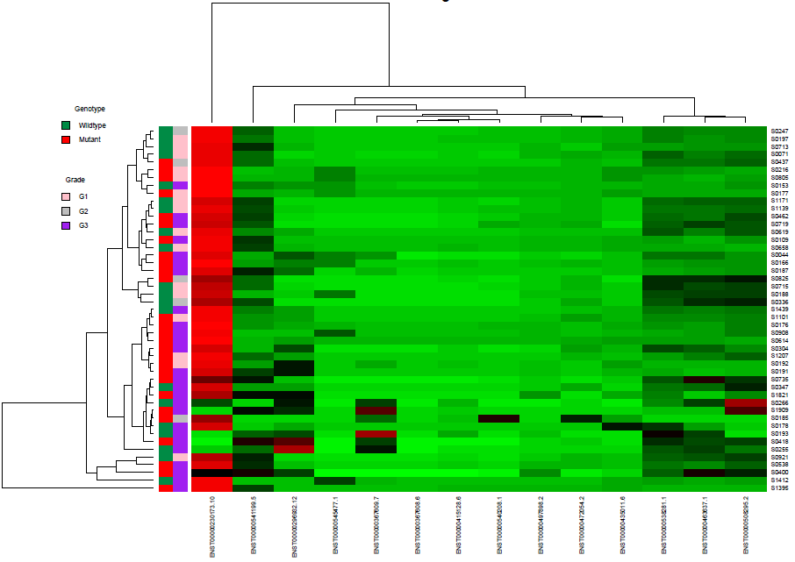
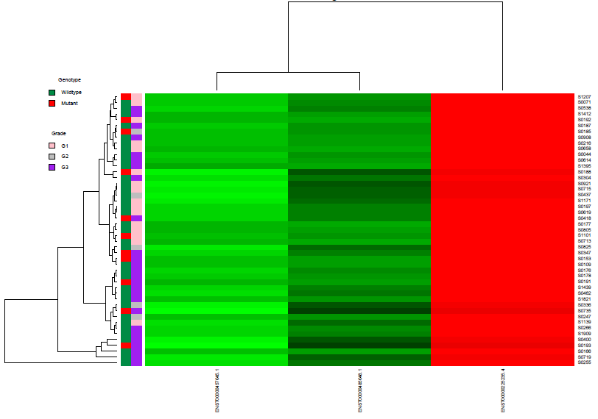
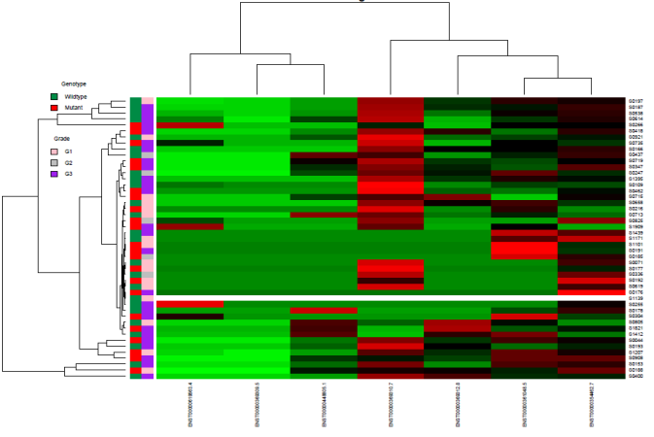
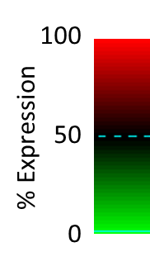
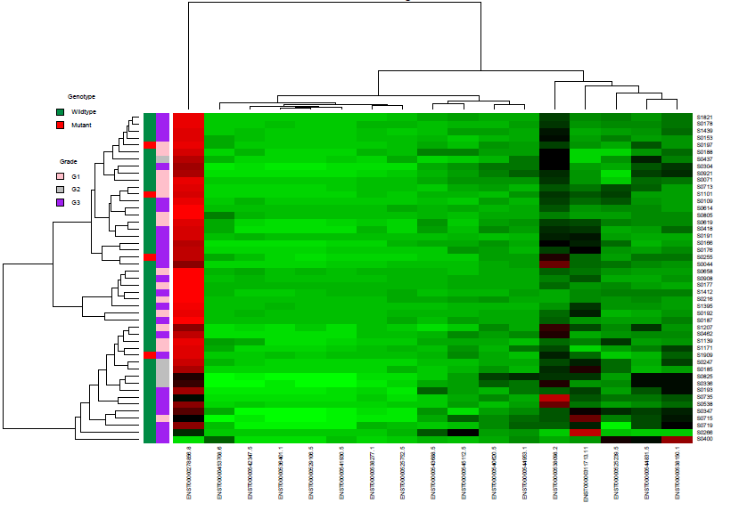
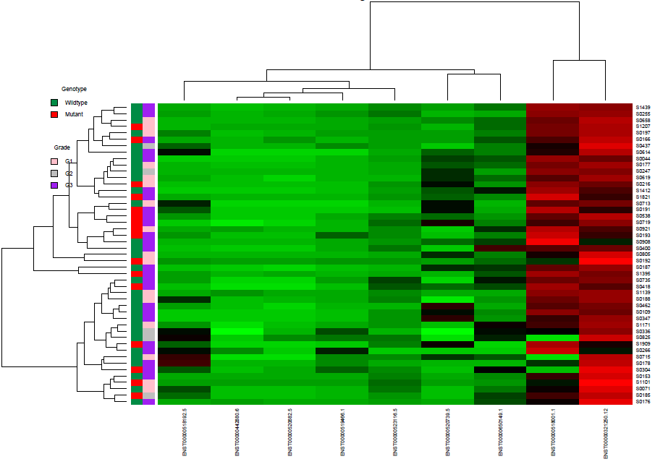
GPR126
Figure S3. Isoform usage in wild type and mutant UBCs. Isoforms are clustered on the x-axis and UBCs on the y-axis.
TBC1D12
PLEKHS1
LEPROTL1
WDR74

Slide 4
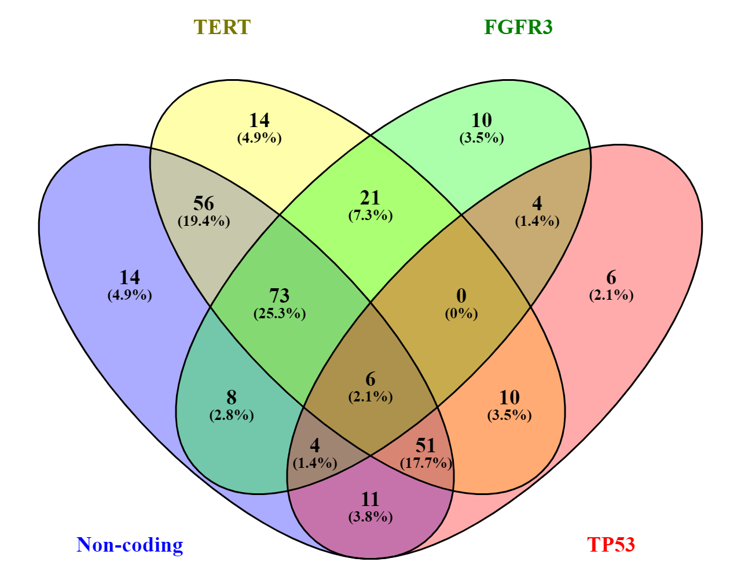
Figure S4. Occurrence of common mutations in 302 UBCs.

